Slide 1
Wireless health monitoring system
Electronics Club project
Summer - 2010
MENTORED by ANKIT SHARMA.
-Anurag Sai
-Sivaram Konanki
-Lokesh Kriplani

Slide 2
Overview
Design a device that collects the bio-metric data(like heart beat, blood pressure).
PPG(Photo Plethysmography).

Slide 3
Principle
Amplify the potential difference across the heart and display the signal.
Filtering the signal.
Microcontrollers to detect peaks and calculate heart-beat.

Slide 4
Problems faced
Unfortunately, the noise due to power supply has corrupted our signal. Even after attenuation, we couldn’t do it.

Slide 5
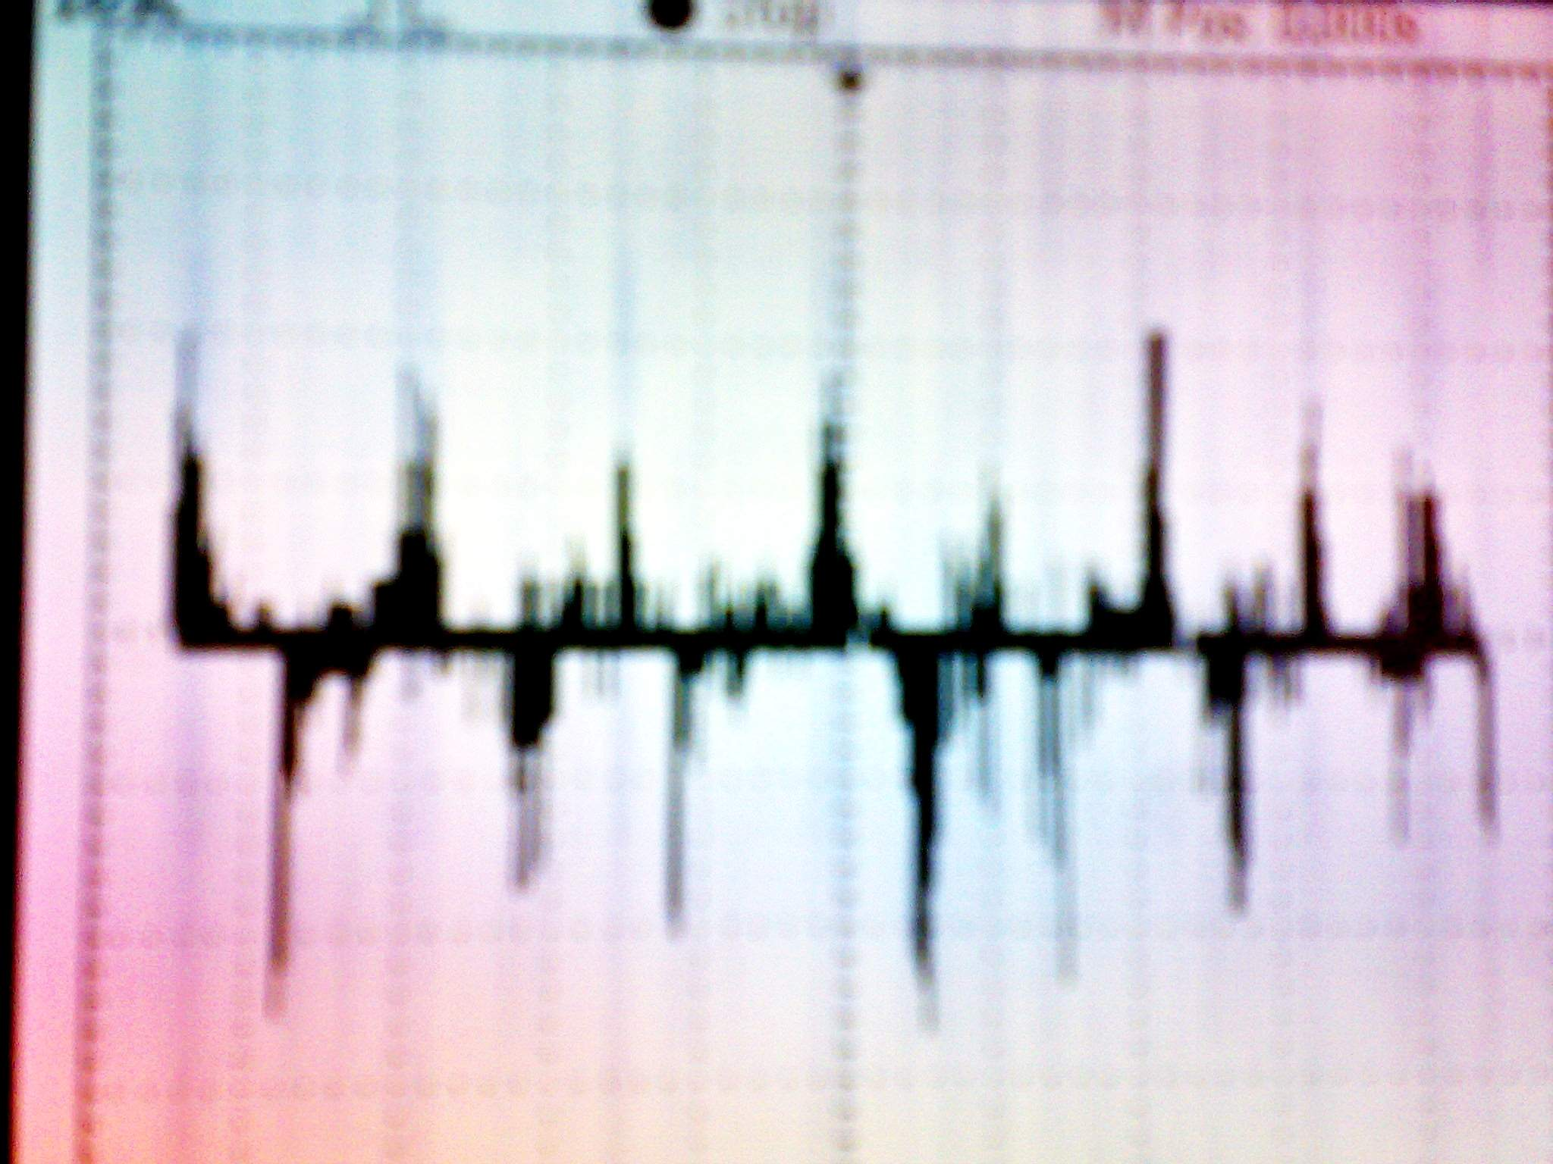
Result
Crude signal we have achieved.

Slide 6
Wireless Transmission
Transmit the ADC values of the signal to the hand-held device through a wireless module.
We have used Rx-Tx(at 2400bps baudrate) to transmit the signal.
Achieved a range of 2 metres.

Slide 7
Possible Improvisations
Plot them using MATLAB.
But, we were not able to find a usb to serial port connector.We bought one but it was not functioning.
So, as time is limited we thought of atleast transmitting them to another MCU and display it on LCD.

Slide 8
The final result…
We were successfully able to transmit the sampled values of the ECG wirelessly from one MCU to another MCU.

Slide 9
What else needs to be done?
The sampled values of the ECG signal could have been sent to laptop and then plotted using MATLAB.
We even thought of showing the temperature of the person, but it was not too accurate.Showing inner body temperature was difficult.
The device could have been small enough to wear it all the day.No one wouldn’t like to have electrodes sticking to their hands all the day!!!!!

Slide 10
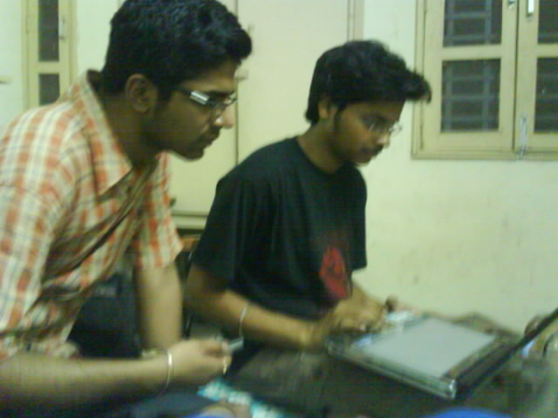
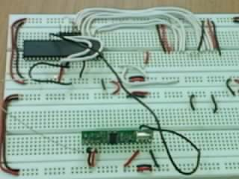
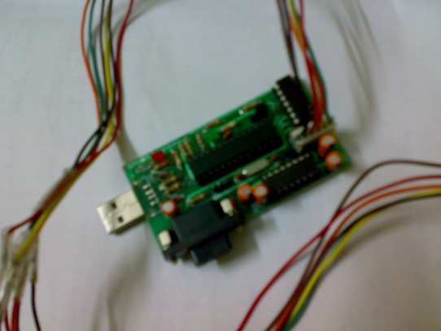
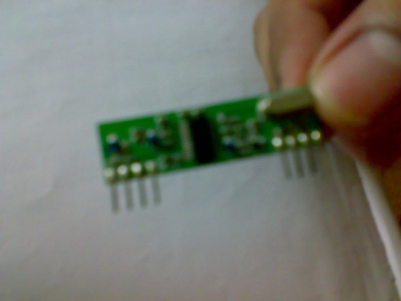
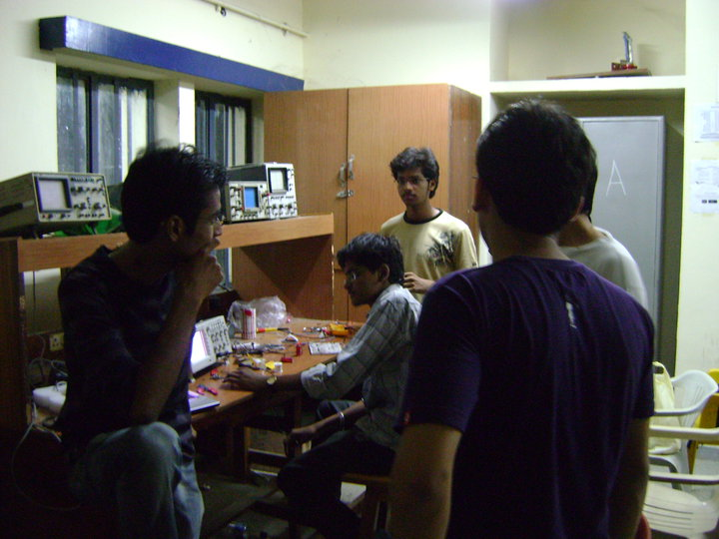

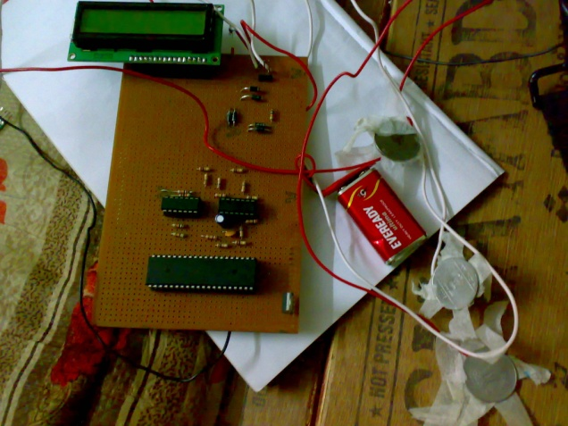
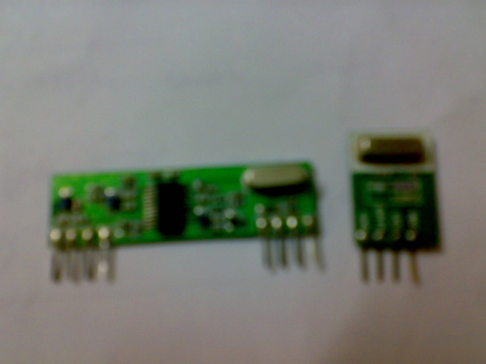
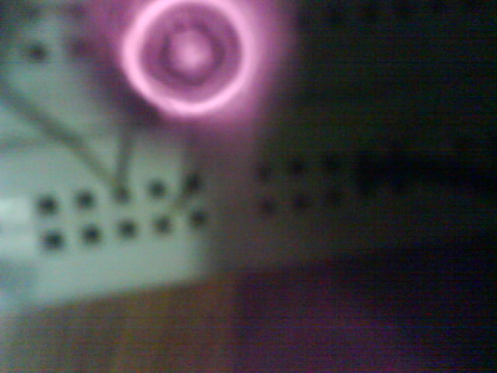
Gallery…

Slide 11
Acknowledgements
We would like to thank E club for giving us a chance to experiment new things and make our holidays exciting ☺
I would personally like to thank cordis and my mentor for their support throughout the journey.

Slide 12
A Healthy Body is home for a happier soul….
On this note I would like to end this presentation.

